Slide 1
Duties of the State & Citizens
Key Stage 1

Slide 2
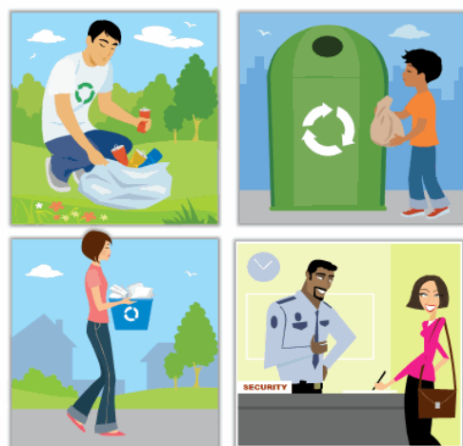

Slide 3
How can we help our community to build a better society?
What responsibilities could we fulfill to our nation?
?

Slide 4

What is a State?
Who is a Citizen?

Slide 5

The Constitution guides us our duties as State and Citizens

Slide 6



WHY DO WE NEED Constitution and Laws?
To protect RIGHTS

Slide 7
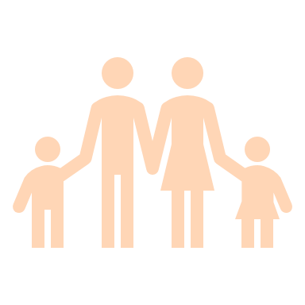

Definition:
Rights
Rights are basic things everyone deserves to have just because they're human.
They're usually protected by laws or what's considered right in society

Slide 8
Fundamental rights and freedoms
The Constitution of Maldives states the essential rights and freedoms for every citizen.
Notes:
Fundamental rights and freedom are necessary for a nation for the growth of every individual and also for safeguarding peoples’ interests. They are crucial for the government in the sense that they serve as the nation’s backbone. In difficult times, citizens can be protected by their rights.

Slide 9
Rights & Responsibility
Rights are freedoms that are protected legally.
Responsibilities are things you should do.

Slide 10


Duties of the state
Protect the natural environment,
Ensure every one is equal by law
Provide basic needs for everyone
      nutritious food
      clean water;
      housing and clothing
      high standards of healthcare;
      a healthy environment;
To ensure every Citizen is entitled with all the basic human rights
      communication,
      media,
      transportation
      sewage and electricity
Notes:
right to privacy, right to education, right to vote, freedom of expression, etc.

Slide 11
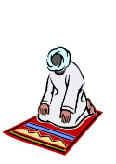
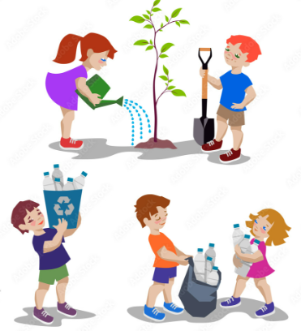

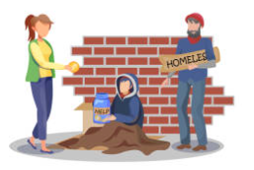

Responsibilities of Citizens
Respect rights of others
Contribute to the community's well-being
Respect the Constitution and Law
Safeguard the State religion of Islam, culture, language, and heritage of the nation
Protect the natural environment.
Respect the national flag, State emblem and the national anthem.

